Slide 1
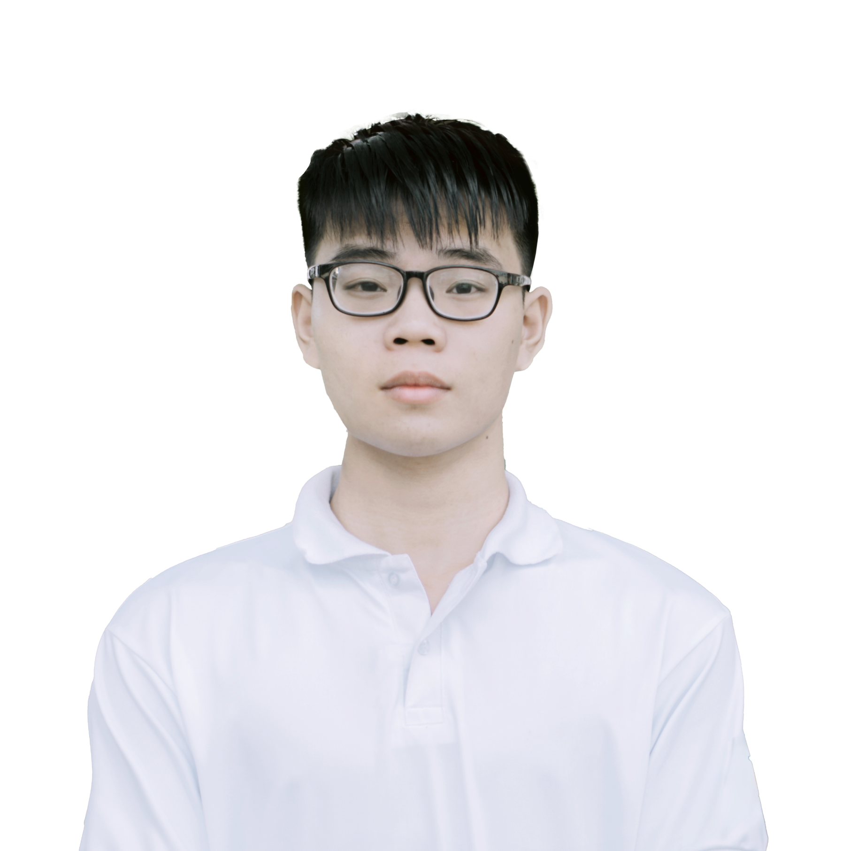















x
NGUYEN DANG LOC
Software engineer
I am a self-motivated and intensely passionate software engineering student with 4 years of experience in programming. I’m creative, open-minded and desire to be a multi-tasker. I believe that my fast learning abilities, dedication to achieve and several awards in relevant fields make me best candidate for this role.
About Me
Objectives
Male
To attain an engaging position as a software engineer
To become a junior developer within 3 years
Desire to be trained as well as learn and grow in professional enviroment
January 17, 2002
District 9, HCM City, Vietnam
Experiences
Contact
2021 Apr - Present
Smart Agri - Project Manager
(+84) 0357 543 620
Main responsibilities:
Planning, executing and monitoring the deployment process of a app
Leading other 4 team members
Recognition & gains:
High marks and favorable feedbacks from course lecturer
Deeper understanding of an app development process
locnd.fpt@gmail.com
linkedin.com/locnd283
Mar 2020 – Sep 2020
Computerholic Community - Member of Technical Team
Education
Main responsibilities:
Built, managed a web platform for sharing knowledge, connecting IT students
Recognition & gains:
Achieved more than 500 users on the platform, over 5000 fanpage followers
Sep 2020 - Present
FPT University (HCM City)
BEng in Software Engineering
Aug 2017 Aug – Dec 2019
Aug 2017 – Aug 2020
High School – Member of Gifted Team in IT
Quang Trung High School
for the Gifted, Binh Phuoc
Main responsibilities:
Learned algorithms, data structure, programming languages
Participated in competitive programming contests
Recognition & gains:
Fundamental knowledge of informatics to prepare for higher development
Developed a personal coding style and major mindset
Mathematics major
Honors & Awards
Sep 2020
Skills
Full ride scholarship
Algorithms & Data Structure
Good
FPT University
C/C++
Excellent
Apr 2019
Java
Good
Sliver medal
Python
Good
Vietnam Southern Provincial Olympiad 30/4 in Informatics
HTML/CSS, JavaScript
Average
Dec 2019
Designing, editing
Excellent
Second prize
PTS, AI, PR, AE
Informatics Olympiad for High school student
Microsoft Office
Good
Interests
Words, Excel, Powerpoint,…
Language
Photography, Film-making,
Travelling, Swimming
Vietnamese, English (Good)

Slide 2
July 22. 2021
Nguyen Dang Loc
Nguyen Xien Street, Long Thanh My Ward, District 9
Ho Chi Minh City, 71216
Mr. Thanh Tran, Talent Acquisition Manager
GMO - Vietnam Lab LLC
02 Hong Ha Street, Ward 2, Tan Binh District
Ho Chi Minh City, 71216
Dear Mr.Thanh:
Your recruitment information for a Java software engineer on LinkedIn very appeals to me since the job requirements are a perfect match for my training and experience.I'm thrilled at the opportunity of demonstrating my professional expertise and problem-solving abilities, which would make a significant contribution to the GMO - developer team's success.
I'm a competitive, creative, open-minded programmer that enjoys being challenged and engaged with projects that need me to go outside of my comfort zone. With four years of experience in algorithms, data structures, full-stack web development and systems architecture, I had worked and improved across a wide range of software platforms such as Amazon Web Services, SAP Business One, .etc.
As a former member of the high school club, I was responsible for building a web page for the media club where the staff can create and post multimedia contents, connect the audience and store the students' image memory data of high school. It was my very first high-traffic website project which assisted me a lot in learning more about HTML5, CSS3/SASS, JavaScript and MySQL. After that, I was instrumental in structuring a lite ERP software comprising resources management tools, performance indicator reporting, and production workflow tracking. It helped optimize the time to manage work and personnel about 30% for my customers.
I would like to add some emphasis of my technical skills to a handful that might allow me to contribute to your bottom line:
Remarkable skills in designing, and developing software
Clear understanding of algorithms and data structures
Expertise with software troubleshooting
Compose documentation for future maintenance and upgrades
Custom Web Applications
Data Science
I have attached a copy of my résumé. I’m best reached ime via email at locnd.fpt@gmail.com anytime or my phone number (+84) 0357 543 620.
Thank you for your time and consideration. I'm looking forward to discussing with you more about the Software Engineer position. I'm excited about the precious opportunities to put my extensive abilities to work for GMO - Vietnam Lab.
I hope to hear from you soon to schedule an interview if luck is on my side.
Sincerely,
Loc
Nguyen Dang Loc.
NGUYEN DANG LOC
Software engineer
I am a self-motivated and intensely passionate software engineering student with 4 years of experience in programming. I’m creative, open-minded and desire to be a multi-tasker. I believe that my fast learning abilities, dedication to achieve and several awards in relevant fields make me best candidate for this role.

